Slide 1

FPGA Design for Embedded Systems
[Video Title]
[Instructor Name(s)]
[Department Name]
Hardware Description Languages for Logic Design
Copyright © 2019 University of Colorado

Slide 2
Objectives
Acquire proficiency designing digital circuits with Field Programmable Gate Arrays (FPGA)s
Employ industry-standard tools to design and implement programmable logic solutions using several Hardware Description Language (HDL) design entry methods, including VHDL, Verilog and System Verilog
Build proficiency by designing basic digital programmable logic circuits in VHDL, Verilog and System Verilog
Copyright © 2019 University of Colorado

Slide 3
Recap: FPGA Design Flow
Design Entry: Schematic or HDL
Place and Route or Fitting
Timing Analysis and Simulation
Functional Simulation
Synthesis or Mapping
Programming the Device
Test and Integration
Release
Copyright © 2019 University of Colorado

Slide 4
FPGA Design Flow: Design Entry
Design Entry: Schematic or HDL
Place and Route or Fitting
Timing Analysis and Simulation
Functional Simulation
Synthesis or Mapping
Programming the Device
Test and Integration
Release
Copyright © 2019 University of Colorado

Slide 5
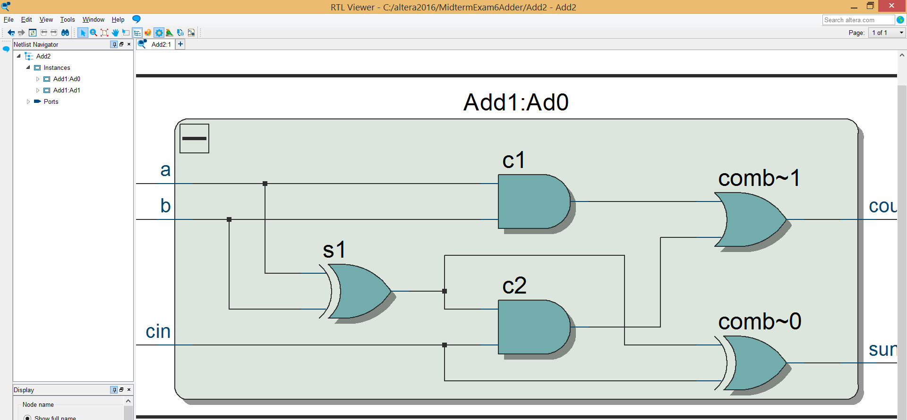

FPGA Design Entry Methodologies
Schematic Entry
Logical correlation between schematic design entry and circuit implementation
Not always transferrable between different FPGA tools and technologies
Difficult to scale for larger designs
Copyright © 2019 University of Colorado

Slide 6
FPGA Design Entry Methodologies
Hardware Description Languages (HDLs)
VHDL
Verilog
System Verilog
Copyright © 2019 University of Colorado

Slide 7
HDL Key Concepts
Describing a hardware circuit implementation that your tool chain will eventually interpret and synthesize into FPGA logic cells
HDL is concurrent, not sequential
FPGA logic cells are hardware; inherently executes in parallel
CPU code is software; inherently executes in sequence
Copyright © 2019 University of Colorado

Slide 8
Summary
Review the FPGA design flow
Explore FPGA design entry options
Introduce key concepts of using Hardware Description Languages (HDLs) to describe circuit implementations
Copyright © 2019 University of Colorado

